Slide 1
Secure Data Hiding In Images Using Steganography
CAPSTONE PROJECT
Presented By: V.Jalagandaiswaran
Student Name : V.Jalagandaiswaran
College Name & Department : Panimalar Institute Of Technology
/ Electrical Electronics Engineering (EEE).

Slide 2
OUTLINE
Problem Statement
Technology used
Wow factor
End users
Result
Conclusion
Git-hub Link
Future scope

Slide 3
Problem Statement
In the modern digital era, safeguarding data security and privacy is of utmost importance. Conventional encryption techniques, while effective, are often susceptible to detection and interception, making secure communication a challenge. Our project addresses this issue by leveraging steganography to seamlessly embed confidential messages within images. This technique provides a discreet and secure communication channel, ensuring data confidentiality while minimizing the risk of detection. By combining encryption with steganographic principles, our solution enhances digital security, making it an ideal approach for sensitive information exchange.

Slide 4
Technology used
Programming Language: Python
Libraries:
OpenCV for image processing
Tkinter (with ttk) for the GUI
NumPy for efficient array manipulation
Stepic – For encoding and decoding hidden messages in images.
Pillow (PIL) – For image handling and processing.
Platform: Cross-platform (Windows/Linux).
Tools: Visual Studio Code, Python 3, Pip.

Slide 5
Wow factors
Employs advanced LSB steganography, securely embedding both the passcode and message length within the image header for enhanced security.
Utilizes a lossless PNG format, ensuring data integrity and preventing any visual degradation of the carrier image.
Features an intuitive, modern GUI, offering seamless encryption and decryption with a user-friendly experience.
Integrates cutting-edge image processing techniques, enabling secure and covert data transmission without raising suspicion.

Slide 6
End users
Cybersecurity Professionals & Enthusiasts – Individuals working in cybersecurity who need secure methods for data concealment.
Journalists, Activists & Government Agencies – Professionals requiring encrypted communication channels to ensure data confidentiality.
Students & Researchers – Those interested in exploring data privacy, cryptography, and steganography techniques for academic and professional purposes.
General Users & Privacy-Conscious Individuals – Anyone seeking enhanced digital security to protect sensitive information from unauthorized access.

Slide 7
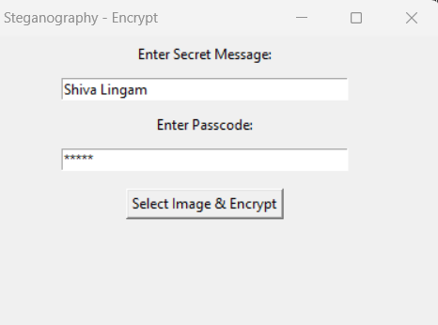
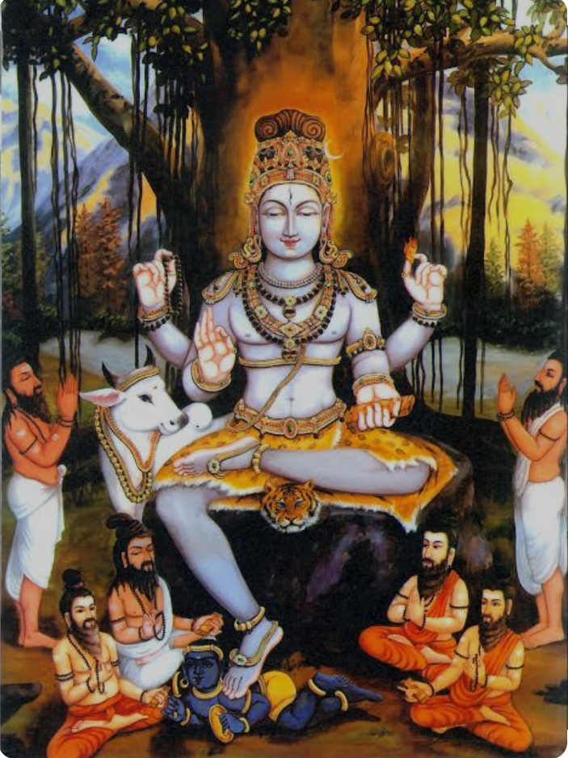
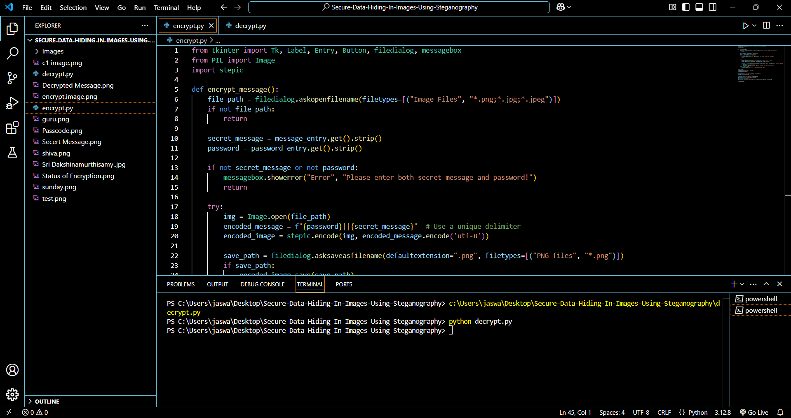
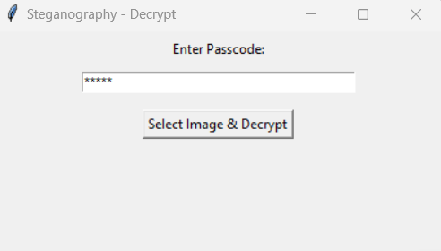
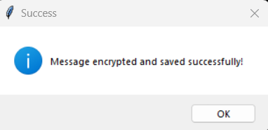
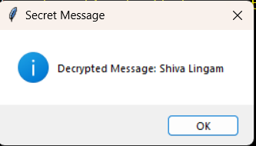
Results
Encrypted image

Slide 8
Conclusion
Our project presents an innovative approach to data security, leveraging LSB steganography to discreetly embed information within images.
Ensures high security and undetectability, incorporating critical header details like passcodes and message lengths for robust protection.
The user-friendly GUI enhances the accessibility of the method, making it a practical tool for secure communication.
This project contributes to the field of digital privacy and covert data transmission, providing a practical and reliable solution for secure information exchange.

Slide 9
GitHub Link
https://github.com/Jaswanth1818/AICTE-Project-Secure-Data-Hiding-In-Images-Steganography./tree/main

Slide 10
Future scope(optional)
Expand compatibility with multiple image formats and higher-resolution images to improve versatility and security.
Extend the methodology to video steganography, enabling dynamic and real-time data hiding.
Integrate advanced encryption algorithms to further enhance message security and resilience against attacks.
Develop a web-based or mobile application, increasing accessibility and ease of use across different platforms.
Explore AI-driven detection and extraction tools to analyze and counteract steganographic threats in cybersecurity.

Slide 11
THANK YOU

